Slide 1
Multithreading

Slide 2
Synchronization
In Java, every object has a lock
To obtain the lock, you must synchronize with the object
The simplest way to use synchronization is by declaring one or more methods to be synchronized
When a synchronized method is invoked, the calling thread attempts to obtain the lock on the object.
if it cannot obtain the lock, the thread goes to sleep until the lock becomes available
Once the lock is obtained, no other thread can obtain the lock until it is released. ie, the synchronized method terminates
When a thread is within a synchronized method, it knows that no other synchronized method can be invoked by any other thread
Critical data could be updated inside the synchronized method

Slide 3
Example
public class Counter{
private int count = 0;
public int getCount(){
return count;
}
public setCount(int count){
this.count = count;
}
}
In this example, the counter tells how many an access has been made.
If a thread is accessing setCount and updating count and another thread is accessing getCount at the same time, there will be inconsistency in the value of count.
The problem is known as ‘race condition’

Slide 4
Fixing the example
public class Counter{
private static int count = 0;
public synchronized int getCount(){
return count;
}
public synchoronized setCount(int count){
this.count = count;
}
}
By adding the synchronized keyword we make sure that when one thread is in the setCount method the other threads are all in waiting state.
The synchronized keyword places a lock on the object, and hence locks all the other methods which have the keyword synchronized. The lock does not lock the methods without the keyword synchronized and hence they are open to access by other threads.

Slide 5
What about static methods?
public class Counter{
private int count = 0;
public static synchronized int getCount(){
return count;
}
public static synchronized setCount(int count){
this.count = count;
}
}
In this example the methods are static and hence are associated with the class object and not the instance.
Lock applied across all instances of the class
Hence the lock is placed on the class object that is, Counter.class object and not on the object itself. Any other non static synchronized methods are still available for access by other threads.

Slide 6
Common Synchronization mistake
public class Counter{
private int count = 0;
public static synchronized int getCount(){
return count;
}
public synchronized setCount(int count){
this.count = count;
}
}
The common mistake here is one method is static synchronized and another method is non static synchronized.
This makes a difference as locks are placed on two different objects. The class object and the instance and hence two different threads can access the methods simultaneously.

Slide 7
Object locking
The object can be explicitly locked in this way
synchronized(myInstance){
try{
wait();
}catch(InterruptedException ex){
}
System.out.println(“Iam in this “);
notifyAll();
}
The synchronized keyword locks the object. The wait keyword waits for the lock to be acquired, if the object was already locked by another thread. Notifyall() notifies other threads that the lock is about to be released by the current thread.
Another method notify() is available for use, which wakes up only the next thread which is in queue for the object, notifyall() wakes up all the threads and transfers the lock to another thread having the highest priority.

Slide 8
Thread Deadlock
Deadlock occurs when two threads are blocked, with each waiting for the other's lock.
Neither can run until the other gives up its lock, so they'll sit there forever

Slide 9
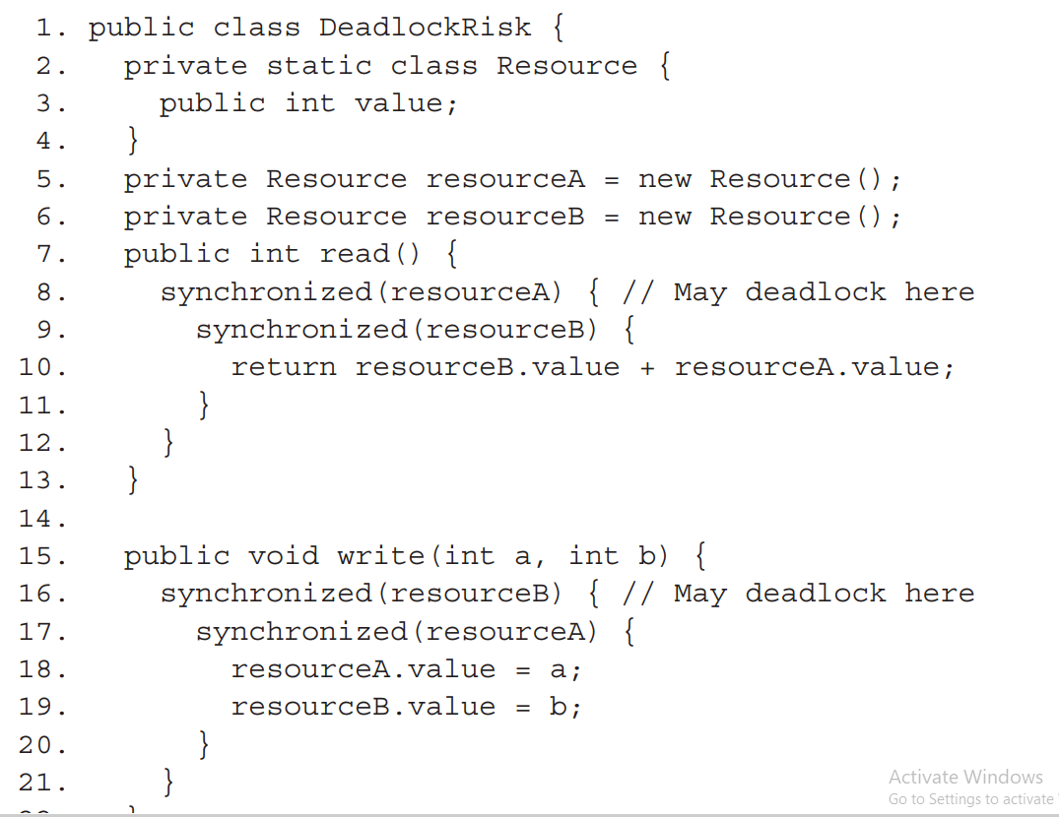
Deadlock
Example

Slide 10
Inter Thread Communication
When multiple threads are running inside an application, most of them will need to communicate with each other in some form.
Threads can communicate each other using wait() and notify()/notifyAll() methods without any race condition.
Wait-and-notify must be used in conjunction with the synchronized lock to prevent a race condition.
sleep() does not release the lock when it is called but method wait() does release the lock.
The only place you can call wait( ), notify( ) or notifyAll( ) is within a synchronized method.
Methods wait(), notify() and notifyAll() are part of the base class Object and not part of Thread, as is sleep(). Why???

Slide 11
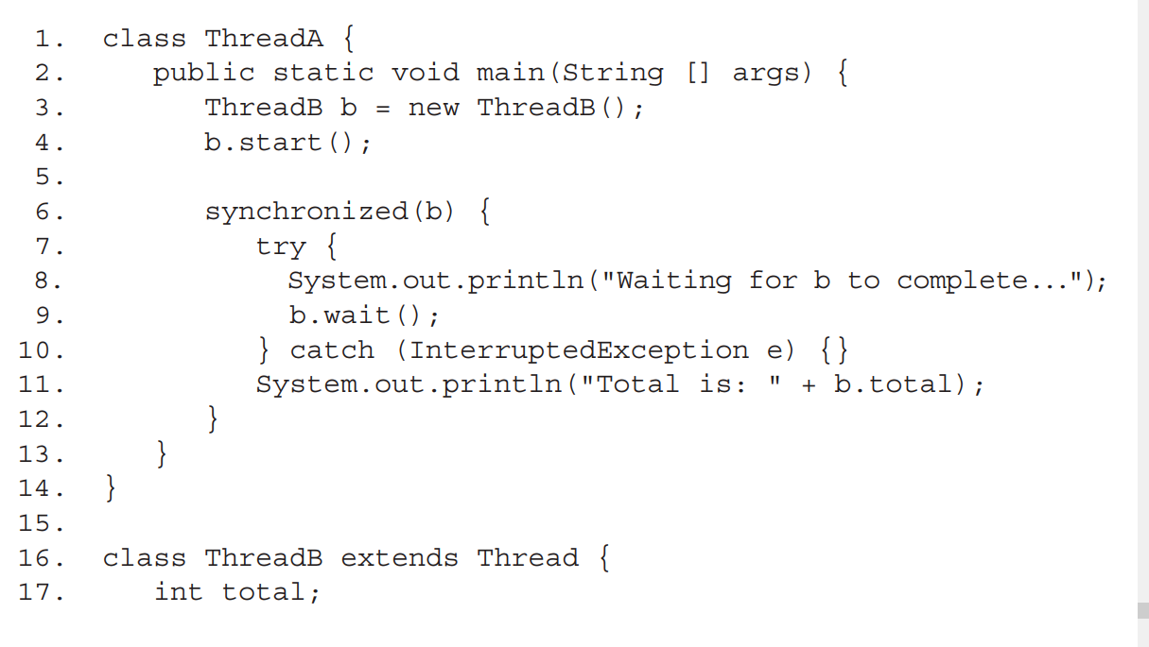
Examples

Slide 12
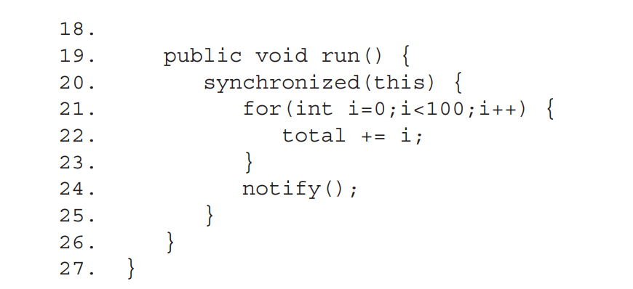
Examples

Slide 13
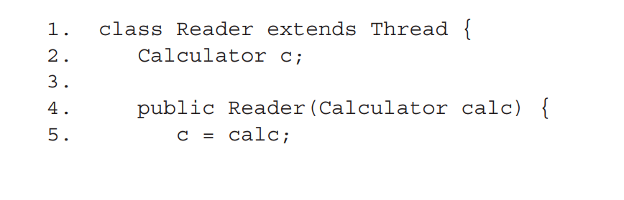
Examples

Slide 14
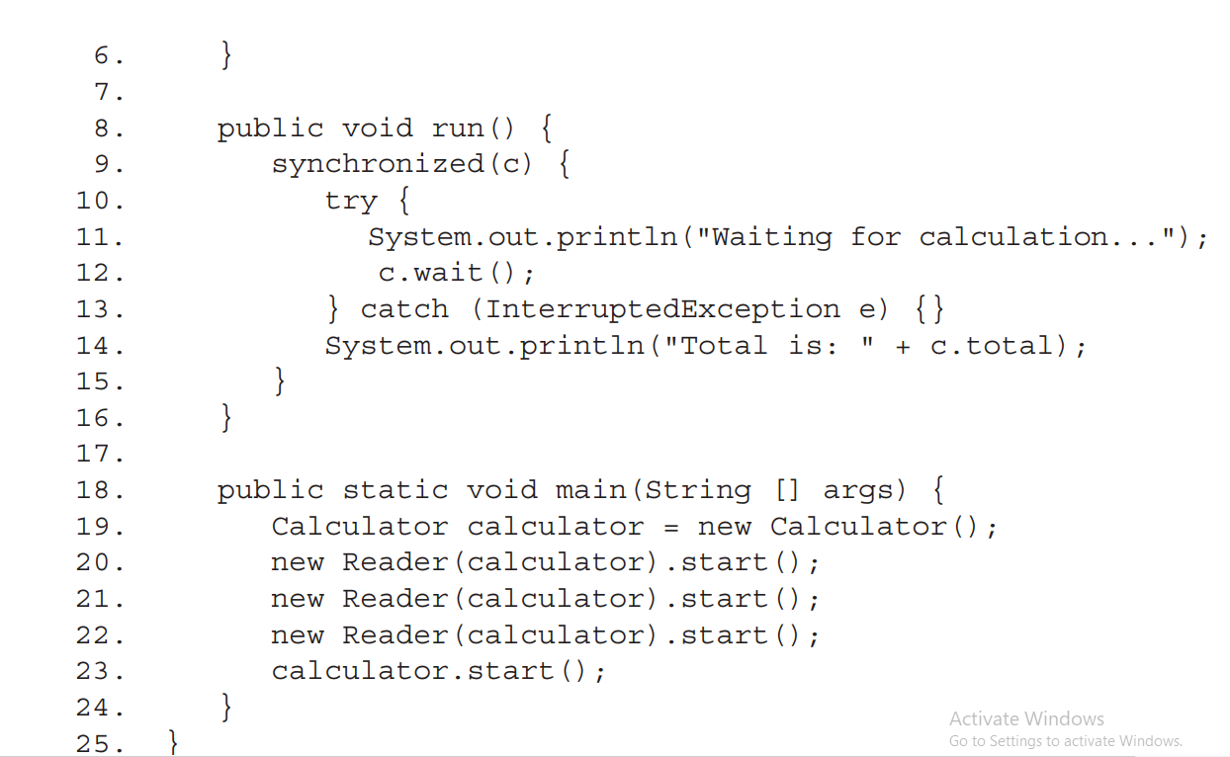

Slide 15
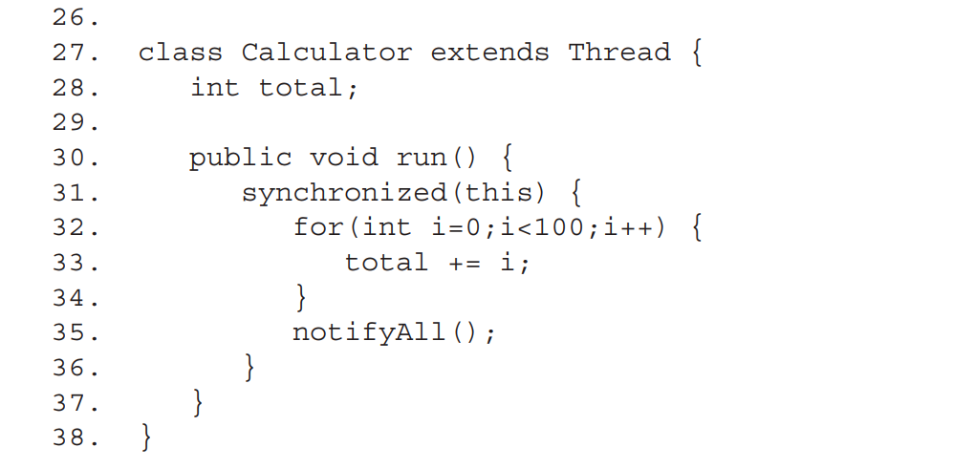

Slide 16
Further Reading
http://docs.oracle.com/javase/tutorial/essential/concurrency/sync.html
http://javarevisited.blogspot.com/2011/04/synchronization-in-java-synchronized.html

